Slide 2
Welcome Remarks
Gail Matthews
Associate General Counsel
American National Standards Institute (ANSI)

Slide 3
Legal Issues Forum Thursday, May 19, 2022 | 10:00am – 3:00pm
Thank you for joining us. The Legal Issues Forum will begin shortly.
Questions may be submitted at any time using the chat. ​
Please keep your audio on mute during the presentations.​
If you would like to ask a question or make a verbal comment, please use the “Raise your hand” option in the Zoom toolbar. When you are called upon, unmute yourself to speak. You may also turn on your camera and your video will be shown on screen in the meeting room.
CLE credits will be available. Sign up in person or listen for a code word to put in the chat for virtual attendees. ​

Slide 4
Keynote Address
Judge Pamela King
District Court Judge Minnesota 3rd Judicial District

Slide 5
Introduction of Panel 1 How Performance Can Be Assessed Against Forensic Standards: The Lab Perspective

Slide 6
Panel 1 How Performance Can Be Assessed Against Forensic Standards – The Lab Perspective
MODERATOR:
Dr. Mary McKiel, ANSI Board Vice Chair and Standards Consultant American Academy of Forensic Sciences – Academy Standards Board
PANELISTS:
Linda Jackson, Director Virginia Department of Forensic Sciences
Scott Oulton, Associate Deputy Assistant Administrator Drug Enforcement Administration (DEA) Office of Forensic Sciences
Brad Putnam, Senior Director of Accreditation, Forensics ANSI National Accreditation Board (ANAB)
Peter Stout, President and CEO Houston Forensic Science Center, LLC

Slide 7
History of Forensic Standards and Accreditation
Linda Jackson
Director, Virginia Department of Forensic Sciences

Slide 8
Forensic Science Accreditation
ASCLD recognized need to develop standards that would help improve the quality and consistency of work performed by crime laboratories
ASCLD/LAB - First FS accreditation program beginning 1982
ASCLD/LAB signatory to both the IAAC Multilateral Recognition Arrangement and the ILAC Mutual Recognition Arrangement in 2009
Strengthening Forensic Science in the United States: A Path Forward published 2009
ISO/IEC 17025 and ISO/IEC 17020
Changes to laboratory management systems, case documentation, and reporting for conformance to standards

Slide 9
Drug Analysis 2005

Slide 10
Drug Analysis Report 2022
Item 1 One sealed plastic evidence bag containing twenty-three plastic bag corners containing off-white solid material
RESULTS AND INTERPRETATIONS
Item 1 Utilizing a hypergeometric sampling plan, the contents of fourteen bags were analyzed separately and each was found to contain Cocaine base (Schedule II); total net weight of the fourteen: 2.427 ± 0.319 grams of solid material. Based on these results, there is a 95% level of confidence that at least 90% of the packages contain Cocaine base. The gross weight of the remainder was 12.332 gram(s) including innermost packaging. [Methods: CT, TLC, IR and GC-MS]. Measurement uncertainty of weight measurements is reported at a 95.45% level of confidence. Methods: Color Tests (CT), Thin Layer Chromatography (TLC), Infrared Spectroscopy (IR) and Gas Chromatography- Mass Spectrometry (GC-MS) Date(s) of testing: 02/07/2022 – 02/10/2022. Supporting examination documentation is maintained in the case file. The above listed methods are those approved for use at the time of analysis. All methods can be found in the Controlled Substances Procedures Manual, which can be found at www.dfs.virginia.gov/documentation-publications/manuals/.

Slide 11
Federal Involvement with Standard Setting in Forensic Sciences
Scott Oulton
Associate Deputy Assistant Administrator,
Drug Enforcement Administration (DEA) Office of Forensic Sciences

Slide 12
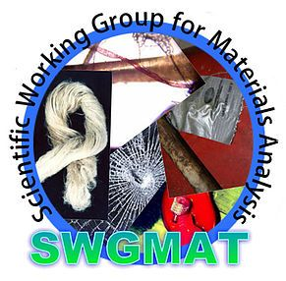
Scientific Working Groups

Slide 13
SWGDRUG Mission
To improve the quality of the forensic examination of seized drugs and to respond to the needs of the forensic community by supporting the development of internationally accepted minimum standards, identifying best practices within the international community, and providing resources to help laboratories meet these standards.

Slide 14
Standard Development Organizations (SDO)
SWGDRUG has brought all of their recommendations (except ethics and analogue determinations) to ASTM – The following are now internationally recognized standards/practices.
ASTM Standards:
E2327-15: Standard Practice for Quality Assurance of Laboratories Performing Seized-Drug Analysis
E2329-17: Standard Practice for Identification of Seized Drugs
E2548-16: Standard Guide for Sampling Seized Drugs for Qualitative and Quantitative Analysis
E2549-14: Standard Practice for Validation of Seized-Drug Analytical Methods
E2764-11: Standard Practice for Uncertainty Assessment in the Context of Seized Drug Analysis
E2882-19: Standard Guide for the Analysis of Clandestine Laboratory Evidence
E2917-19: Standard Practice for Forensic Science Practitioner Training, Continuing Education, and Professional Development Programs (Replacing E2326-14)
E3255-20: Standard Practice for Quality Assurance of Forensic Science Service Providers Performing Forensic Chemical Analysis

Slide 15
Judge Edwards on SWGs

Slide 16
That Was Some Criticism
SWGs of questionable value?
Meet irregularly
No clear funding
No membership standards
Not mandated by federal/state govt.
Not enforceable
Standards too general and vague
Don’t measure impact by formal survey

Slide 17
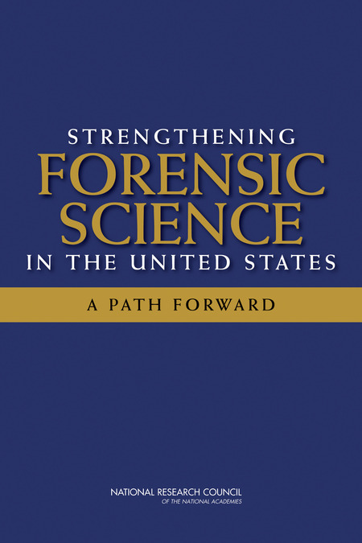
National Academy of Sciences (NAS)
“Strengthening Forensic Science in the United States: A Path Forward” (February 2009)
Provided a total of 13 recommendations

Slide 18
NAS Report Findings
Inadequate educational programs
Lacking mandatory and enforceable standards
Understaffed crime labs and high case backlogs
Thin ties to academic research institutions
No mandatory certification and accreditation programs
Limitations in the knowledge base of some disciplines
Limited funding for academic research
No centralized governing body
Bias towards prosecution

Slide 19
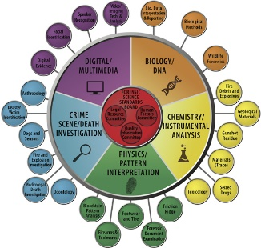
NIST Organization of Scientific Area Committees

Slide 20
OSAC Objective
To create a sustainable organizational infrastructure dedicated to identifying and fostering the development of technically sound, consensus-based documentary standards and guidelines for widespread adoption throughout the forensic science community.

Slide 21
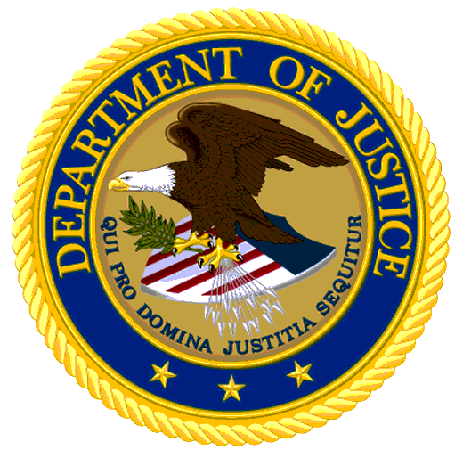
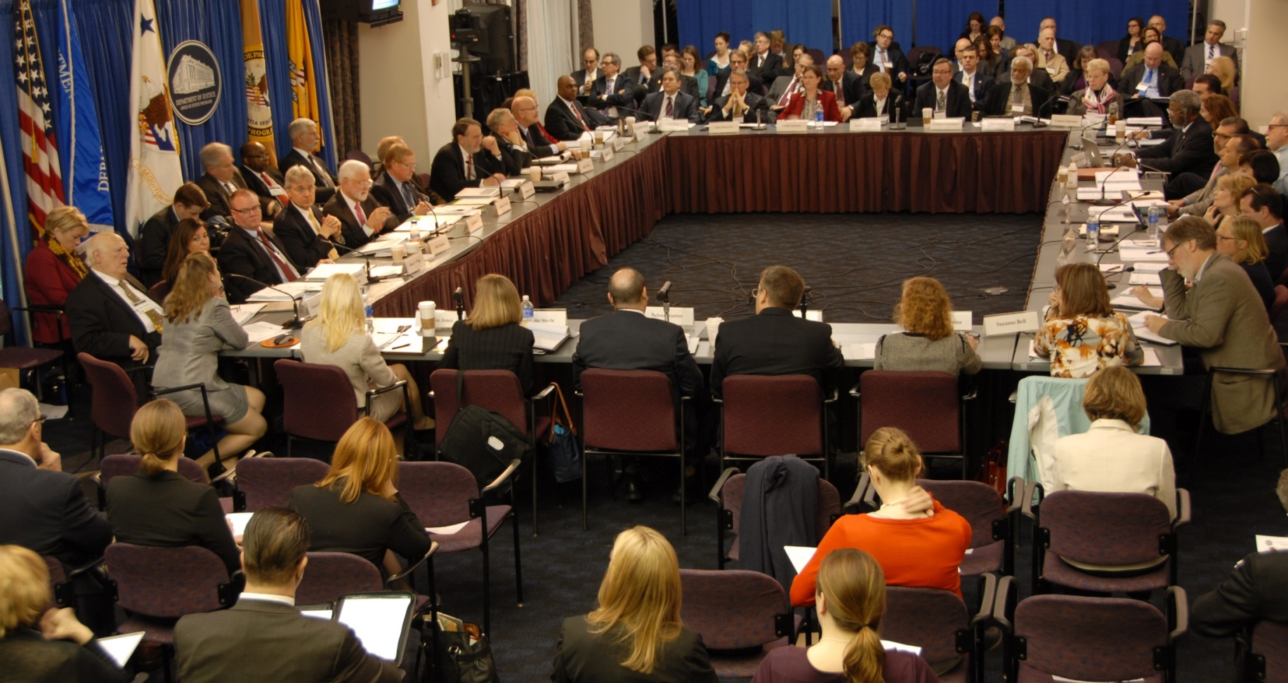
National Commission on Forensic Sciences (NCFS)
37 Commissioners + DOJ/NIST Leadership Team

Slide 22
Pertinent Recommendations Adopted by NCFS
Forensic science methodologies should be evaluated by an independent body
NIST should establish an in-house entity to conduct independent scientific evaluations of the technical merit of test methods and provide those evaluations publicly
Several recommendations served as the basis for the creation of standards

Slide 23
Summary
The Federal Government played a significant role in the development of standards
Standards will continue to be needed/developed for forensic science applications
International standards are enforceable through accreditation and lab policies
The Forensic Community is better because of these initiatives and standards development and implementation

Slide 24
Accreditation has been available to Forensic Service providers for approximately 40 years now, however “standard methods” are a relatively new concept to this sector. Let’s discuss the hurdles to, and impact of, implementing these methods into the forensic laboratory.
Brad Putnam
Senior Director of Accreditation, Forensics ANSI National Accreditation Board (ANAB)

Slide 25
Accreditation is a MINIMUM. It cannot and should never be viewed as the guarantee of performance.
Accredited organizations can and do fail.
Accreditation does not always ensure best practice.
Dr. Peter Stout
President and CEO, Houston Forensic Science Center, LLC

Slide 26
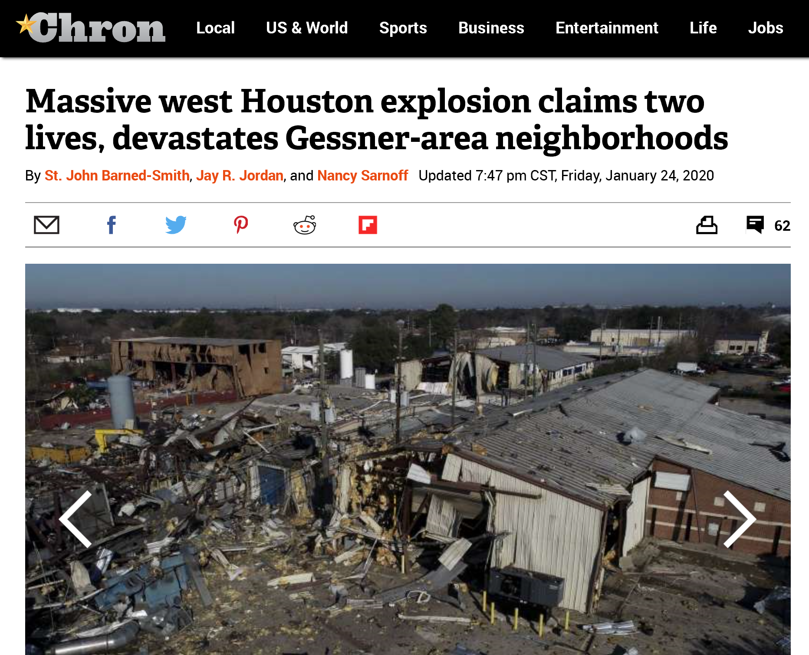
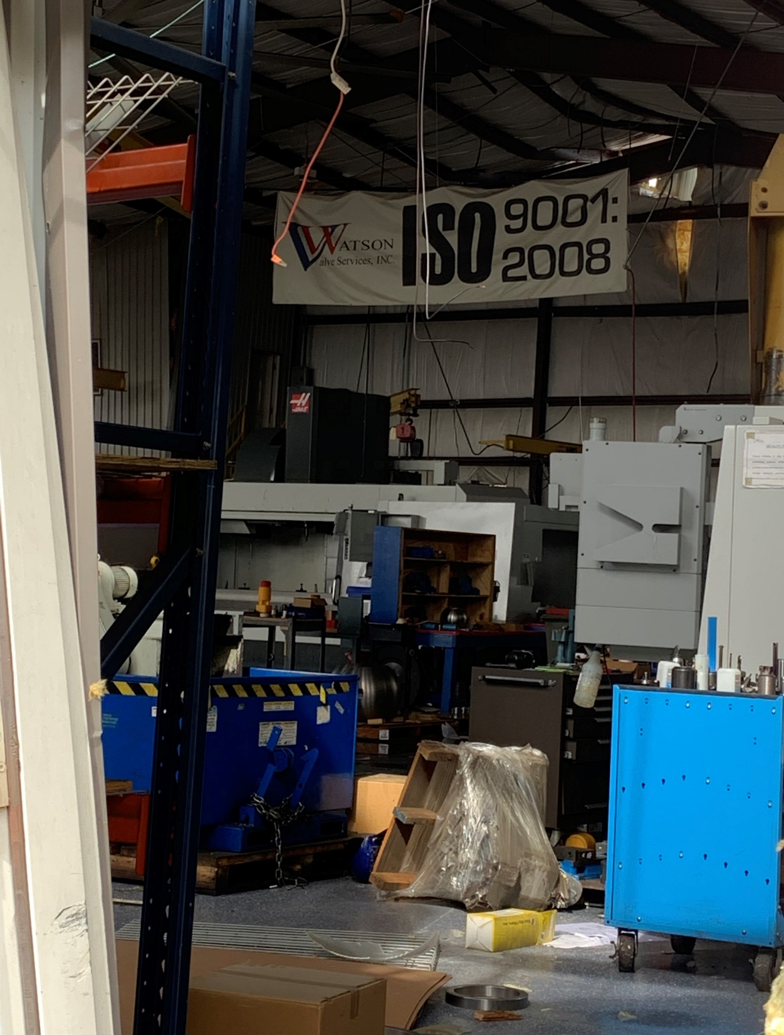

Slide 27
Forensic Science Accreditation
ASCLD recognized need to develop standards that would help improve the quality and consistency of work performed by crime laboratories
ASCLD/LAB - First FS accreditation program beginning 1982
ASCLD/LAB signatory to both the IAAC Multilateral Recognition Arrangement and the ILAC Mutual Recognition Arrangement in 2009
Strengthening Forensic Science in the United States: A Path Forward published 2009
ISO/IEC 17025 and ISO/IEC 17020
Changes to laboratory management systems, case documentation, and reporting for conformance to standards

Slide 28
LUNCH BREAK
We will break for lunch until 1:00pm. For virtual attendees, the Zoom will remain open.

Slide 29
Introduction of Panel 2 How This Plays Out In The Courtroom

Slide 30
Panel 2 How This Plays Out In The Courtroom
MODERATOR
Pamela Sale, Vice President, Forensics ANSI National Accreditation Board (ANAB)
PANELISTS
Sarah Chu, Senior Advisor on Forensic Science Policy Innocence Project
Ted Hunt, Special Counsel - Science and Technology Branch Federal Bureau of Investigation (FBI)
Terri Rosenblatt, Chief of Post-Conviction Justice Unit Manhattan District Attorney's Office
Raymond Valerio, Assistant District Attorney and Director of Forensic Sciences Office of the Queens County District Attorney

Slide 31
How This Plays Out In The Courtroom
Ted Hunt
Special Counsel - Science and Technology Branch,
Federal Bureau of Investigation (FBI)

Slide 32
Prosecutor’s Perspective
Raymond Valerio
Assistant District Attorney and Director of Forensic Sciences
Office of the Queens County District Attorney

Slide 33
Standards are important to admissibility, but standards are not the same as admissibility.
Terri Rosenblatt
Chief of Post-Conviction Justice Unit,
Manhattan District Attorney's Office

Slide 34
International standards development is an emerging practice in the forensic science system. It will take all of us to ensure the criminal legal system's use of standards is harmonized with the essential requirements of the ANSI process.
Sarah Chu
Senior Advisor on Forensic Science Policy Innocence Project

Slide 35
Panel 2 How This Plays Out In The Courtroom
MODERATOR
Pamela Sale, Vice President, Forensics ANSI National Accreditation Board (ANAB)
PANELISTS
Sarah Chu, Senior Advisor on Forensic Science Policy Innocence Project
Ted Hunt, Special Counsel - Science and Technology Branch Federal Bureau of Investigation (FBI)
Terri Rosenblatt, Chief of Post-Conviction Justice Unit Manhattan District Attorney's Office
Raymond Valerio, Assistant District Attorney and Director of Forensic Sciences Office of the Queens County District Attorney

Slide 36
Closing Remarks
Gail Matthews
Associate General Counsel
American National Standards Institute (ANSI)

Slide 37
For CLE Credits
In person: Sign out at the registration table in the lobby
Virtual: Enter code word in chat

Slide 38
Other World Standards Week Events of Interest
THURSDAY EVENING
U.S. Celebration of World Standards Day Standards for Sustainable Development Goals
5:30 pm – 9 pm ET
For more information and to register, visit
www.ansi.org/wsweek

